Slide 1
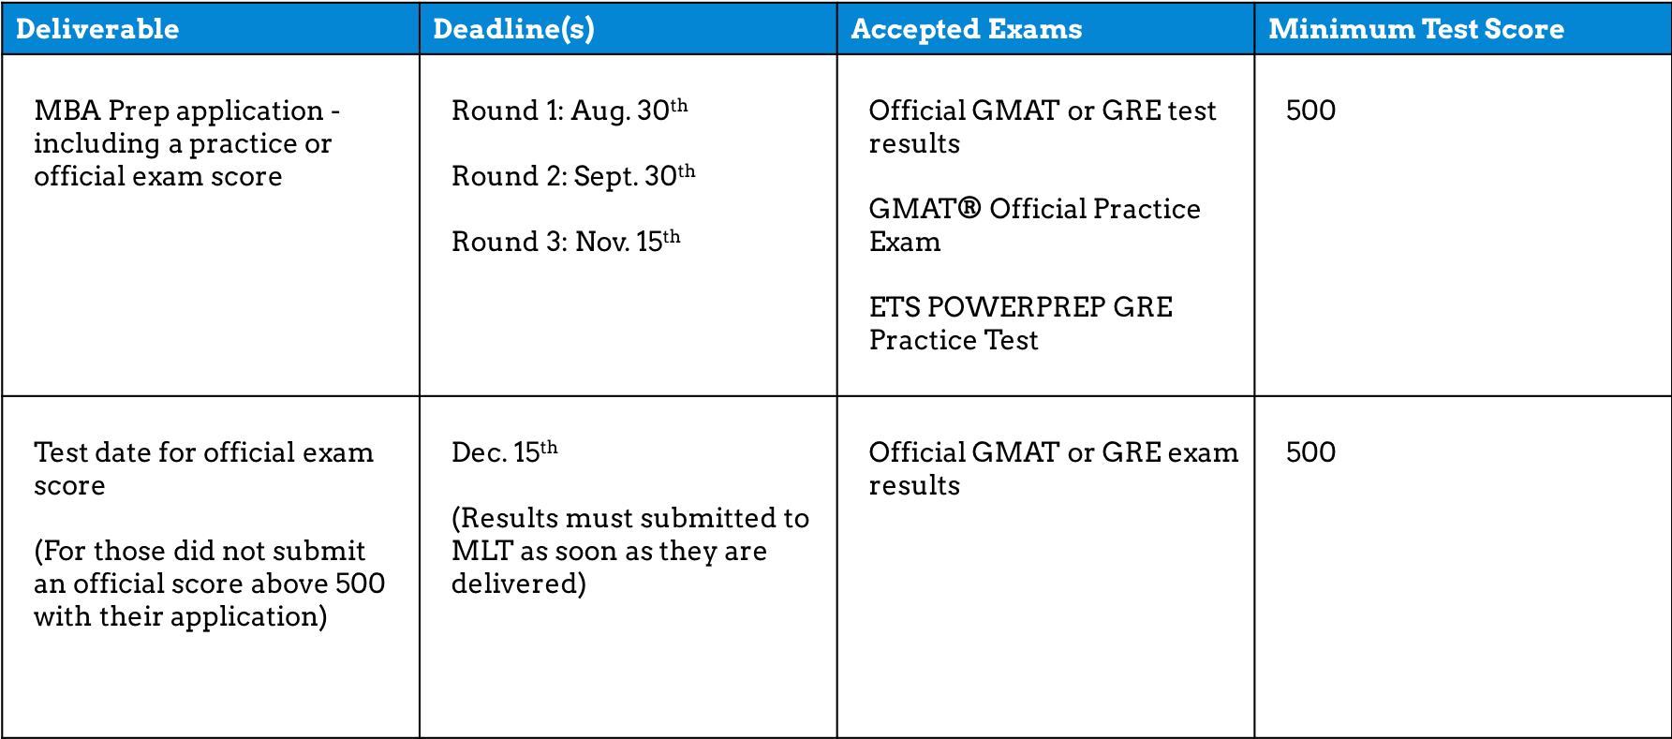

Slide 2
Deliverable | Deadline(s) | Accepted Exams | Minimum Exam Score
MBA Prep application – including an official or practice exam score | Round 1: Aug. 30th Round 2: Sept. 30th Round 3: Nov. 15th | Official GRE or GMAT exam results GMAT® Official Practice Exam ETS POWERPREP GRE Practice Test | 500
Test date for official exam score (This deadline applies for those who did submit an official exam score above 500 with their application.) | December 15th (Exam results must be submitted to MLT as soon as they are delivered to the applicant.) | Official GMAT or GRE exam results | 500

